Slide 1
Distributed Sniffer Nodes for Batteryless Sensor Nodes
(sdmay24-25)
Website
Team Lead/ Software Lead: Thomas Gaul
Hardware Lead: Tori Kittleson
Hardware Member: Matthew Crabb
Software Member: Spencer Sutton
Scribe/Software Member: Ian Hollingworth
Advisor/Client: Henry Duwe
CPRE/EE 492 Spring 2024
https://sdmay24-25.sd.ece.iastate.edu/
Notes:
1

Slide 2
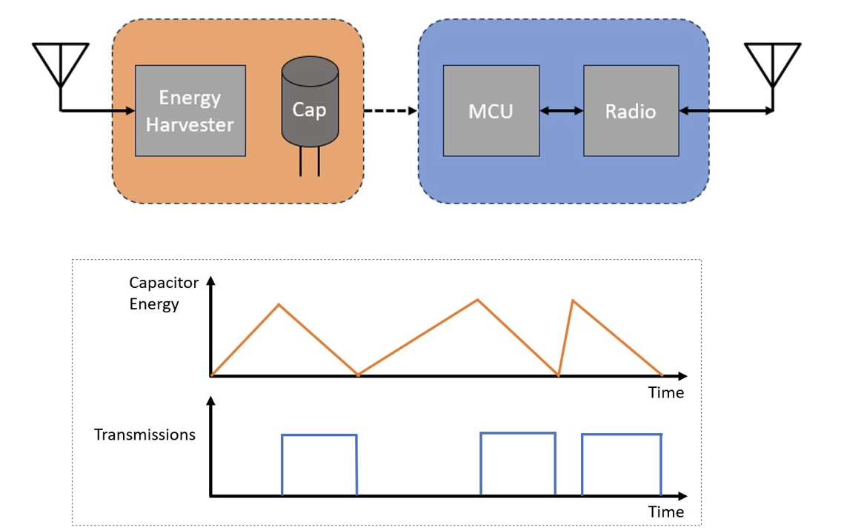
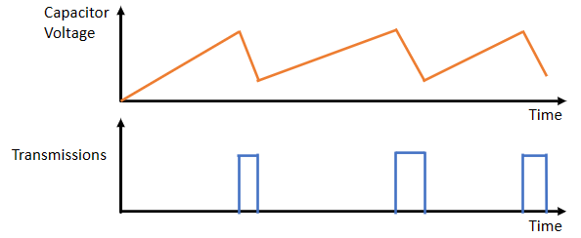
Project Overview
BOB Node - Batteryless sensor designed by client.​
Notes:
Ian
we are in an era of overreliance on architecture simulators, and the effects of this are tangible and detrimental.
Simulator alternatives:
Register Transfer Language
first-order models
BOB nodes are subject to variable on-time due to passive energy harvesting, which necessitates the need for a testbench to understand their behavior

Slide 3
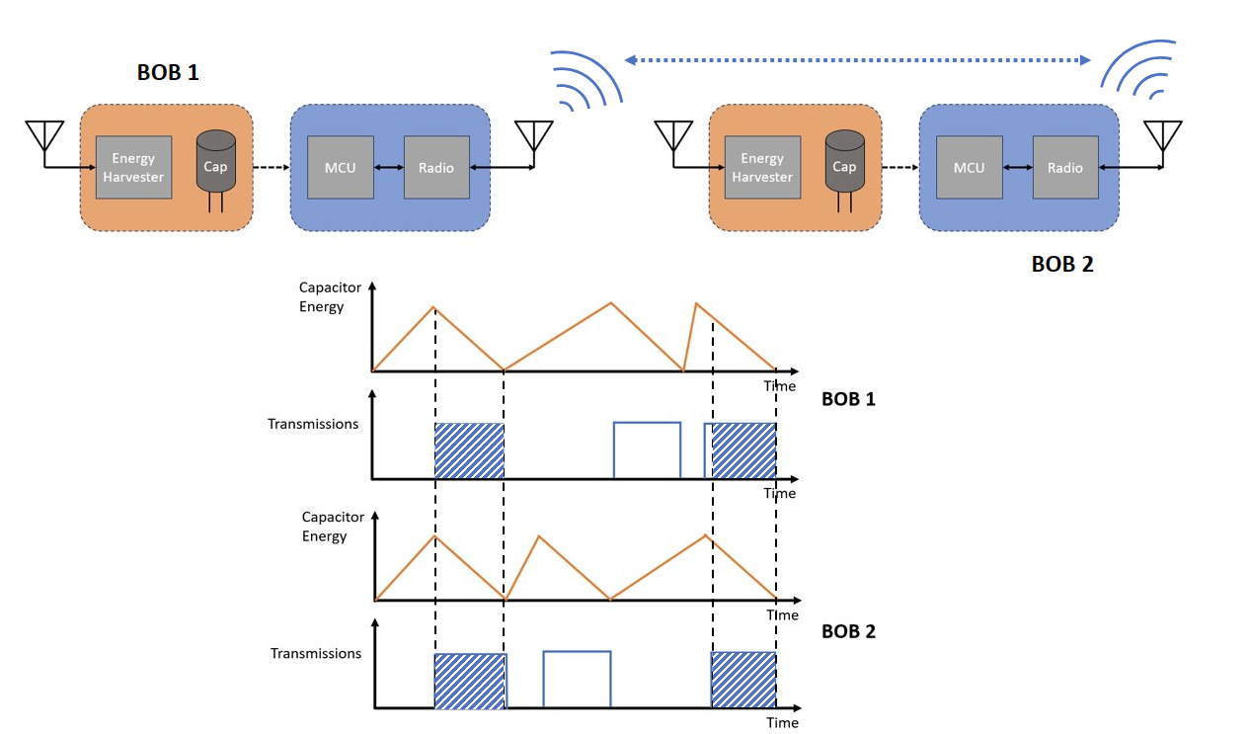
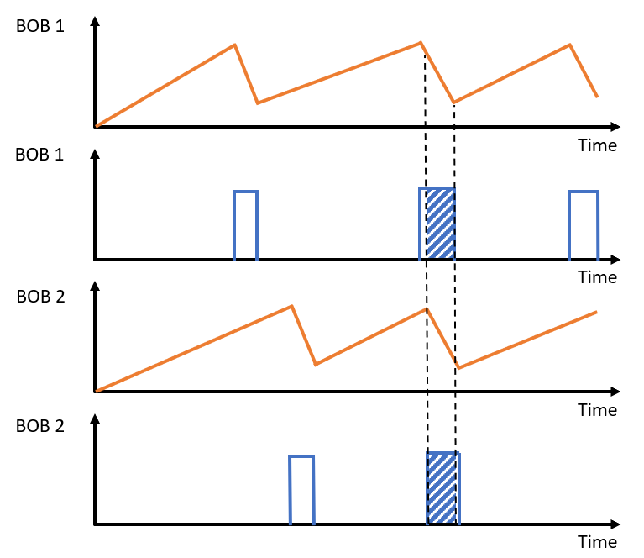
Notes:
Ian
Capacitor charging should be longer than the on-time 20% in reality the capacitor is not depleted to 0

Slide 4
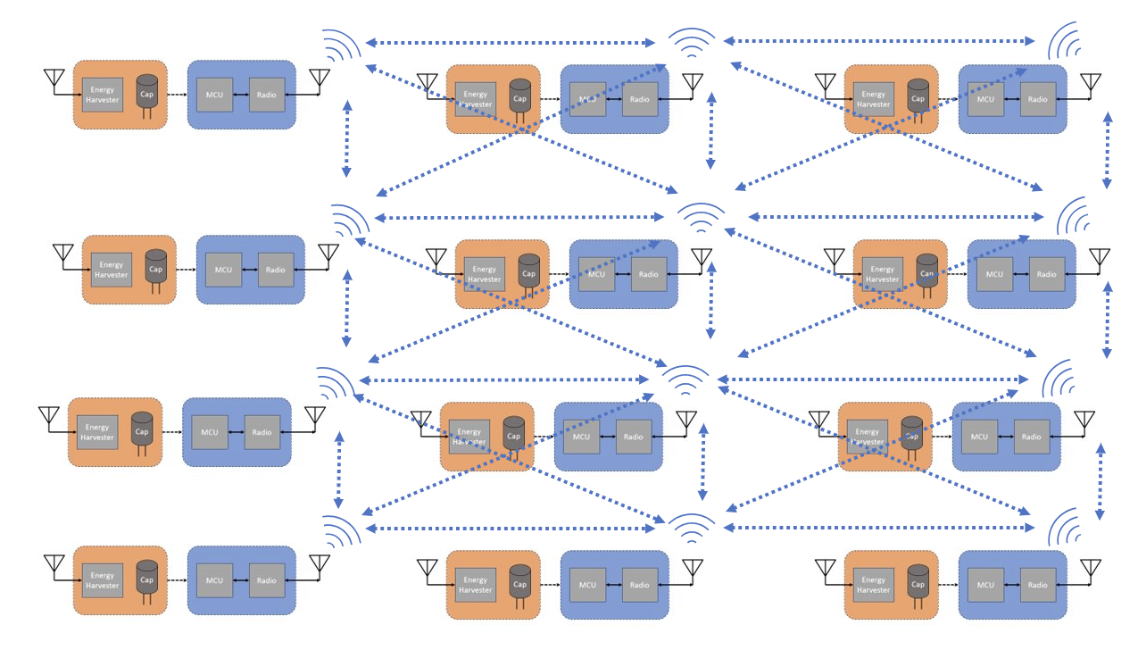
Notes:
Ian
Alignment is not perfect

Slide 5
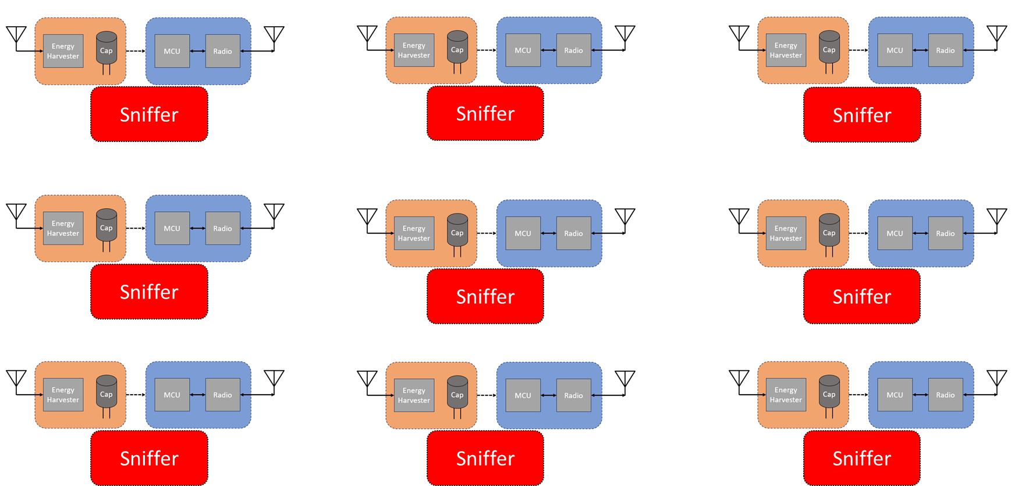
Goal: Create testbed for researchers to use for the batteryless nodes they are developing.
Notes:
Ian

Slide 6
Use Cases
Scenario Node Tests
Single node experiments
Multi-node and single lab experiments
Large scale testing (goal of 100 – 1000)
Users
Dr. Duwe's research group
Universities, companies, hobbyists through open-source nature
Potential Impact
Factory condition monitoring
Weather monitoring and recording
Forest fire detection in national parks
p. 11
Notes:
Ian Aim to make researching wireless sensor nodes networks easier (give test groups)
Specifically designed for Duwe's research group, will deliver open-source resources for any group to design node systems for any use case
Potential systems designed or impacted using testbed data
Focus on users. End goal: 3x3 node. Potential Impact may not need.

Slide 7
Requirements
Functional
9 BOB/Sniffer pairs
Sink Sniffer Node with continuous power
Host system to organize and store Sniffer logs
Sniffer Nodes powered for one week
Sniffer Nodes inflict minimal effects on BOB Nodes
BOB Nodes electrically isolated from one another
Modular stack of BOB and Sniffer custom boards
Non-functional
Scalable for a potential larger (100+ node) design
Documentation
Mechanical durability of system
Deliverables
Breakout Board Hardware
MSP Simplified Hardware
Sniffer Node Hardware
Sniffer Node Software
Open-Source Documentation
Mechanically Sound System
p. 9
Notes:
Tori
**simplify this down and refer to design doc for more details. Can explain requirements verbally
Functional
• Non-functional
• Technical and/or other constraints
• 1-2 slides, 2 minutes
Emphasis challenging ones

Slide 8
Sniffer Design
Tasks
Monitor BOB status via GPIO
Generate events for BOB via GPIO
Monitor BOB radio communication
Send test data to be saved
Sniffer:
Wired Event Generation
Sniffer Network
CC1352
Primary
BOB
Power Monitor
SPI
BOB Comm.
(Sub 1GHz)
Sniffer Band Comm. (2.4GHz)
"Sniffed"
Comm.
CC1352
Relay
BOB
p. 74
Notes:
Thomas

Slide 9
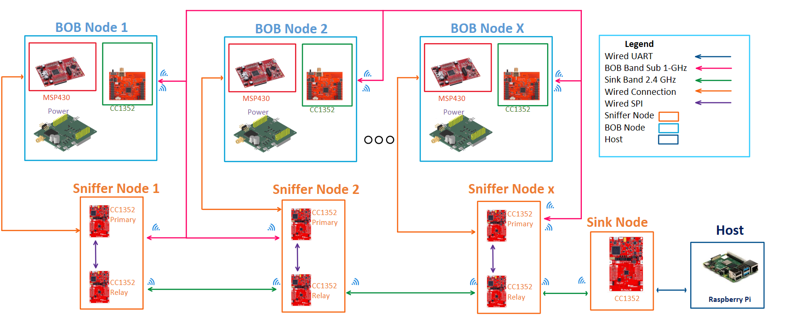
System Design
p. 18
Notes:
Thomas

Slide 10
System Design
UART Connection
Sniffer Band Comm. (2.4GHz)
Sniffer 0x00
Sniffer 0x08
Sniffer 0x10
Host
Sink
Sniffer 0x01
Sniffer 0x09
Sniffer 0x11
Sniffer 0x02
Sniffer 0x0A
Sniffer 0x12
p. 74
Notes:
Thomas

Slide 11
Software Design
Important Packet Parts:
Destination Address
Type
Source
Network Depth
Data
Relay:
Primary:
BOB wireless messages
Sub-1-GHz
Send to Primary
Sniffer wireless messages
Sub-1-GHz
Depending on the Destination Depth
Sniffer Network
QUEUE 1
Enqueue and update address
QUEUE 1
SPI
BOB Power
Cycle Data
QUEUE 2
QUEUE 2
QUEUE 2
p. 32,74
Notes:
Thomas

Slide 12
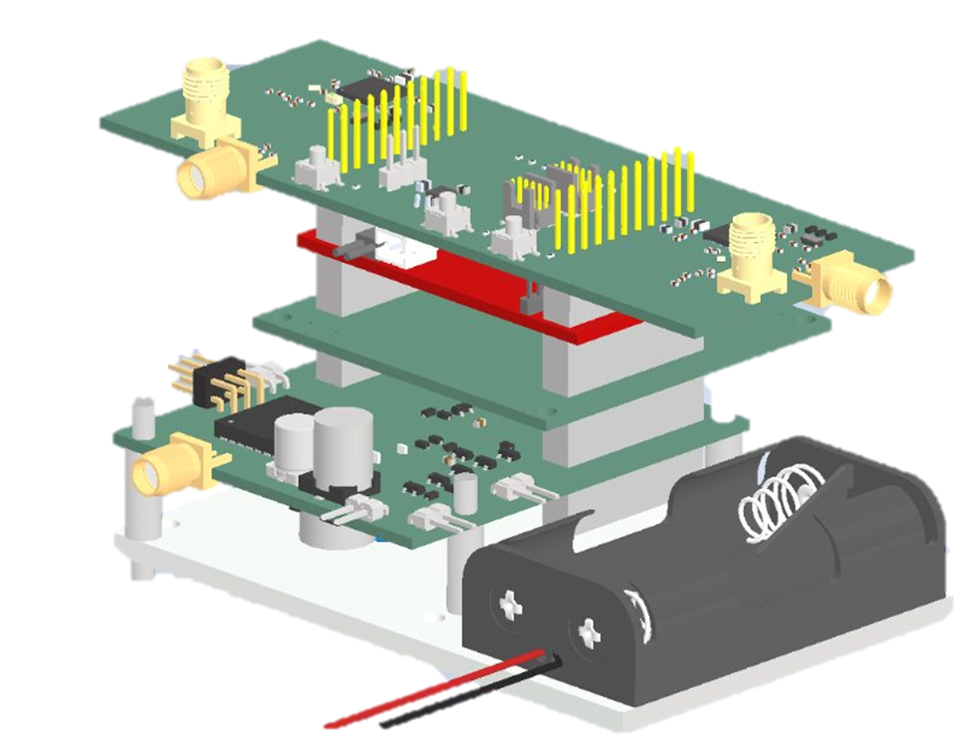
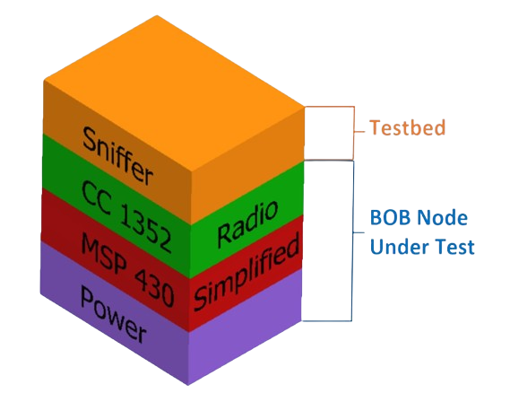
System Physical Design – PCB Stackup and Mounting
p. 19
Notes:
Tori
Good. Little Hard to read power. 3d model of boards possibly

Slide 13
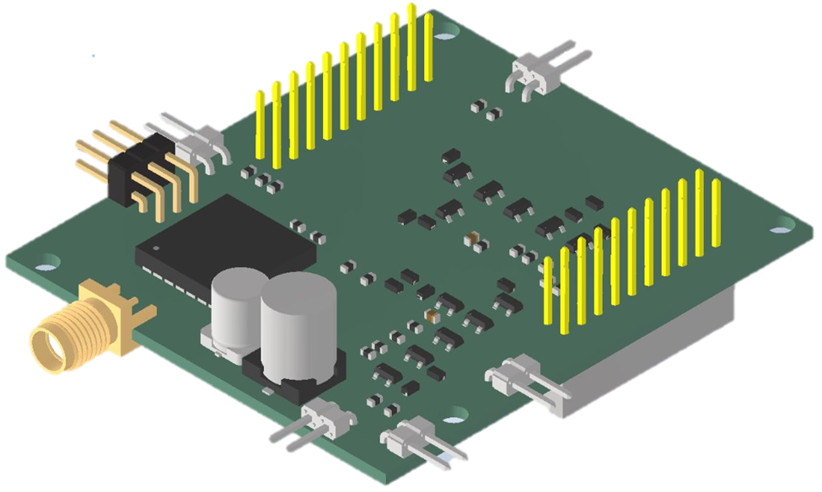
System Physical Design – Power Harvester PCB
p. 19
Notes:
Tori
Good. Little Hard to read power. 3d model of boards possibly

Slide 14
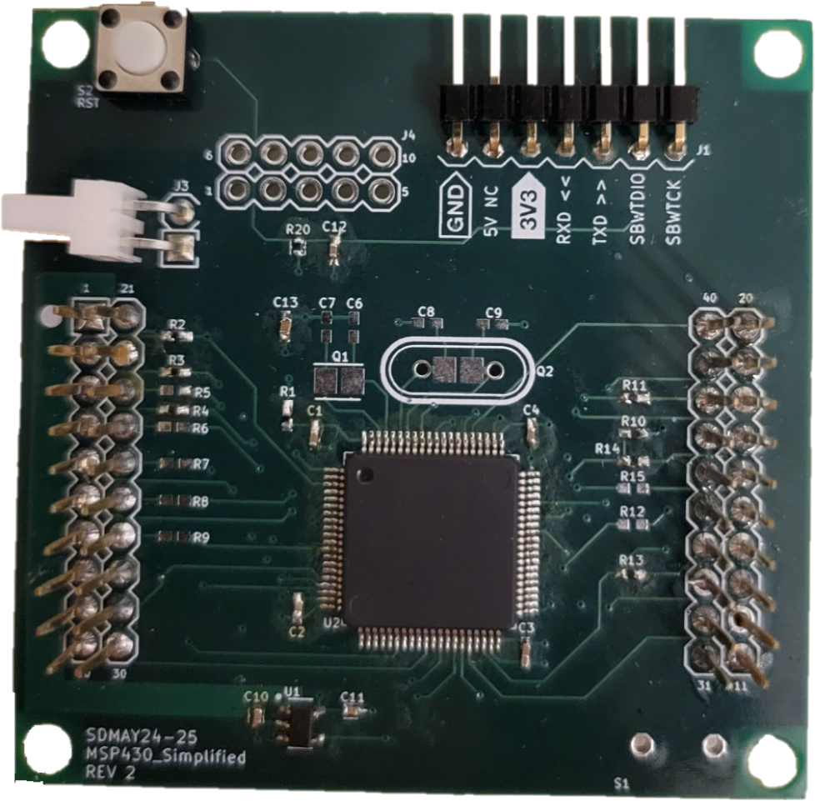
System Physical Design – MSP430 Simplified PCB
p. 19
Notes:
Tori Add 3D component screenshot

Slide 15
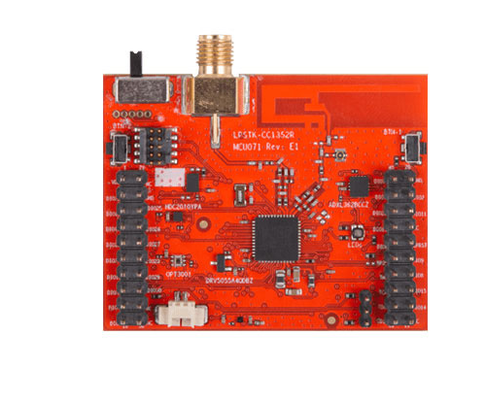
System Physical Design – CC1352 Radio PCB
p. 19
Notes:
Tori
Good. Little Hard to read power. 3d model of boards possibly

Slide 16
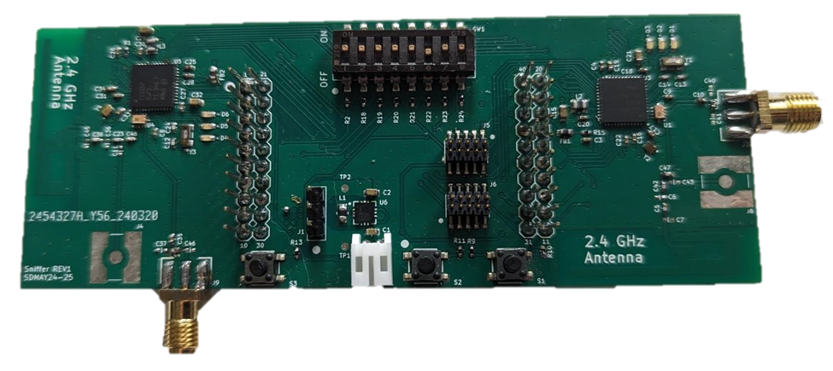
System Physical Design – Sniffer PCB
p. 19

Slide 17
Sniffer PCB Design – Battery System
Chose to use rechargeable NiMH AA batteries
Pros:
Standard size, widely available
Rechargeable 1,000x
Simple, low-cost mounting solutions
Multiple manufacturers
Off the shelf or custom charging solutions
Flexibility
Cons:
Lower capacity than some other options
Charging, protection, fuel gauge ICs not as widely available
p. 71
Notes:
Tori
https://www.lipolbattery.com/LiPo-Battery-10000mAh.html
https://www.nytimes.com/wirecutter/reviews/best-rechargeable-batteries/
https://www.amazon.com/nimh-aa-batteries/s?k=nimh+aa+batteries

Slide 18
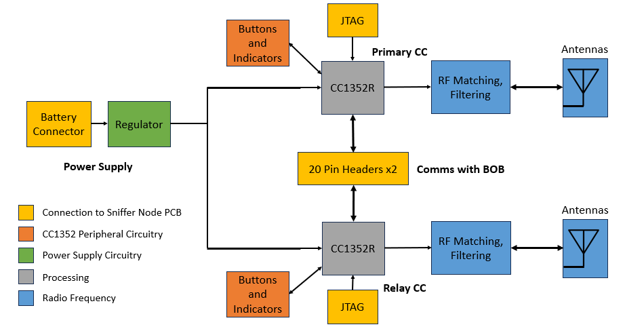
Sniffer PCB Design – Block Diagram
p. 60
Notes:
Matt
Battery seperated
Regulator (safety, I/O)
DIP switch
2 CCs

Slide 19
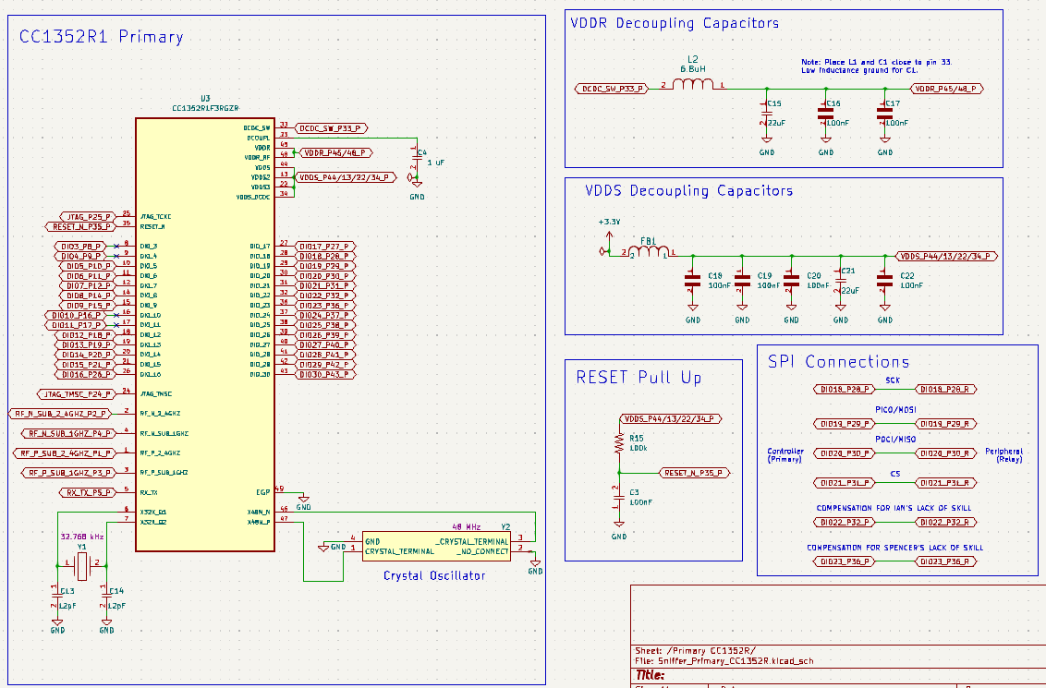
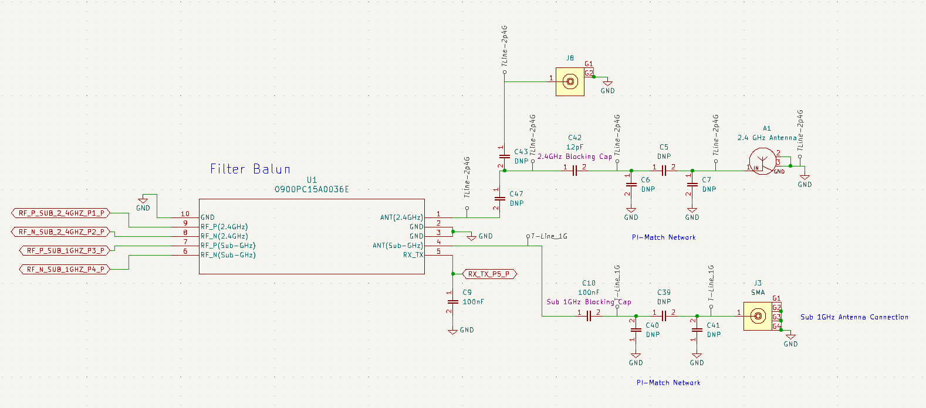
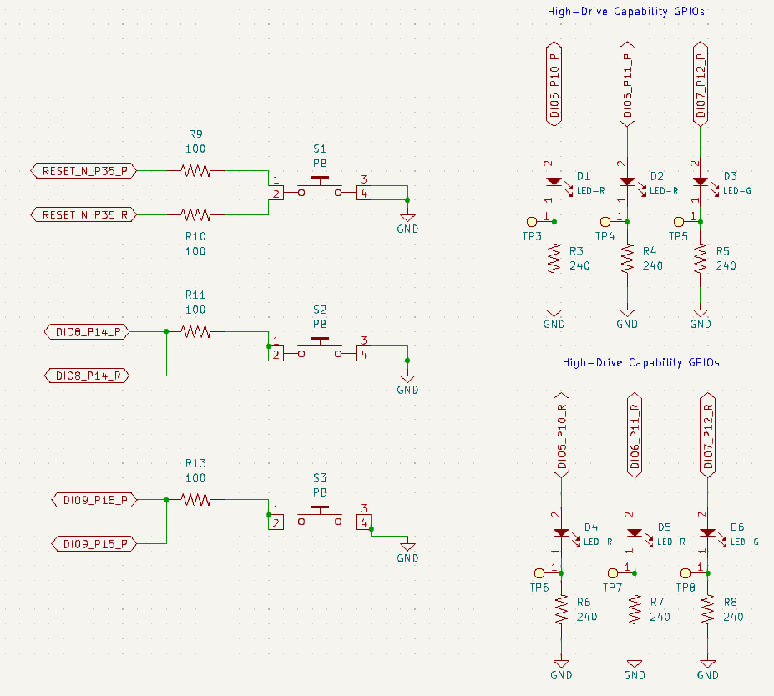
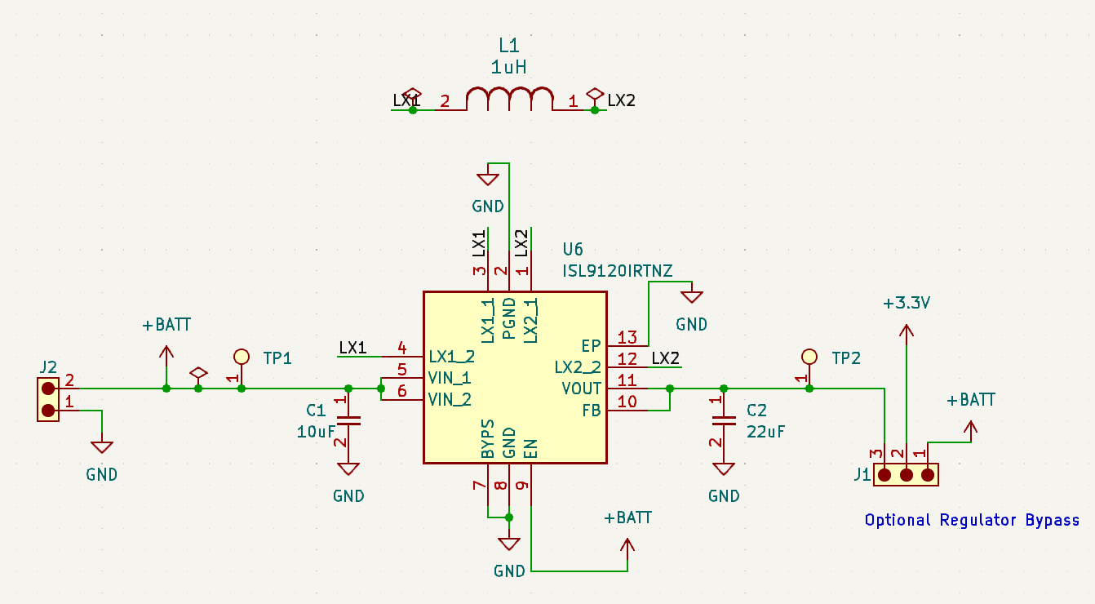
Sniffer PCB Design – KiCad Schematics
RF Frontend
CC1352R and Peripherals
Power Supply
p. 62-69
Buttons + Indicators
Notes:
Matt

Slide 20
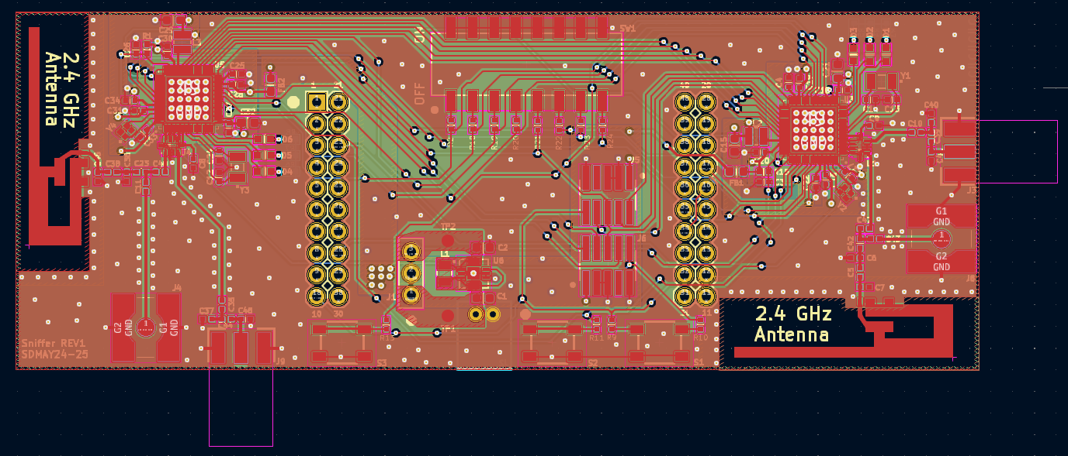
Sniffer PCB Design – KiCad Layout
p. 70
Notes:
Tori
Decoupling cap placement and vias – small current loops – less EMI
Antenna placement – avoid others
RF routing
Ground planes for shielding + lots of vias for low impedance path to ground
Large power planes for low impedance power rail
Nothing under RF sections
Anti-parallel routing to avoid crosstalk

Slide 21
Costs
Senior Design Cost Breakdown
Item | Cost Per Node | Overall Cost
Breakout Board | - | $37.83
MSP_Simplified | ~$31 | $234.60
Sniffer Board | ~$56 | $611.88
Batteries and Chargers | ~$12 | $112.05
Additional parts | - | $29.29
Mechanical Design | ~$4 | $34.60
Total | ~$103 | $1060.25
p. 73
Notes:
Tori

Slide 22
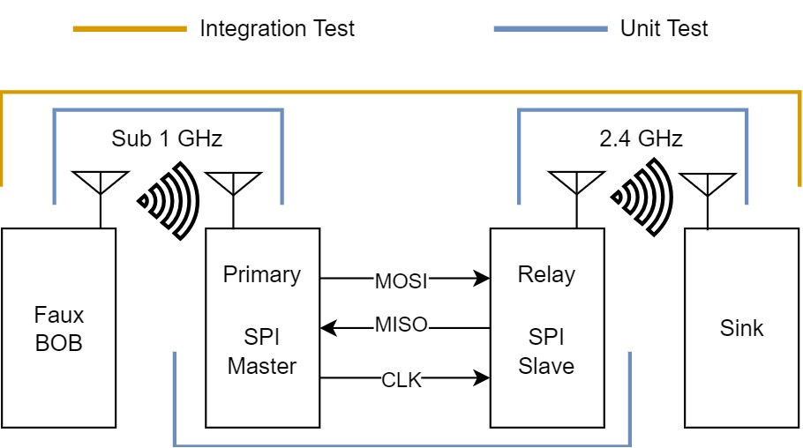
Testing
Unit Test
SPI communication, Sub 1GHz communication, and 2.4 GHz Communication
Electrical continuity and power checks
Programming boards
Integration Tests
SPI with Sub 1Ghz and 2.4 GHz communication
Software with custom hardware
System wide
Data transfer between multiple nodes
p. 34
Notes:
Add cost estimate???

Slide 23
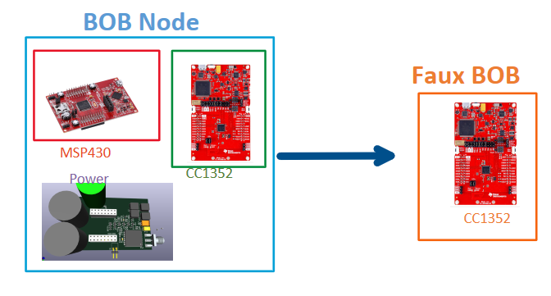
Faux BOB
Goal
Create a test tool
Emulate BOB functionality
Allows us to have a known test
p. 53
Notes:
Fix animation, increase bottom figure text size, BOB band listening/ sniffing, receive/retransmit
Very cluttered, I love it

Slide 24
RF Testing and Tuning
Initial Plan
Use a spectrum analyzer to tune the internal CC1352R load capacitors
Ignore Sub-1GHz matching (all components assumed to have 50Ω ref impedance)
Extract S-parameter information from 2.4GHz PCB antenna using a VNA and match
Problem
Using equipment requires supervision + approval – could not get access until too late
Solution
Model antenna on the computer and simulate its operation
Use simulation tools to find correct matching values
p. 55
Notes:
Matt

Slide 25
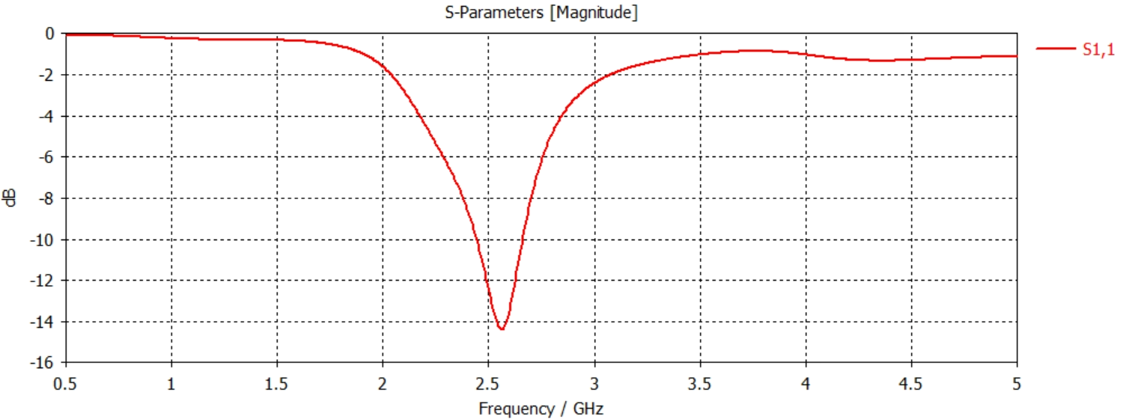
RF Testing and Tuning
p. 55
Notes:
Matt

Slide 26
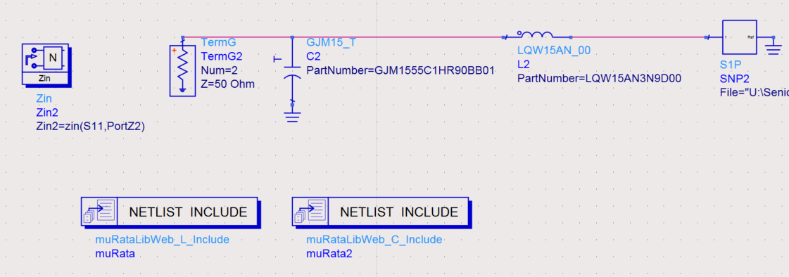
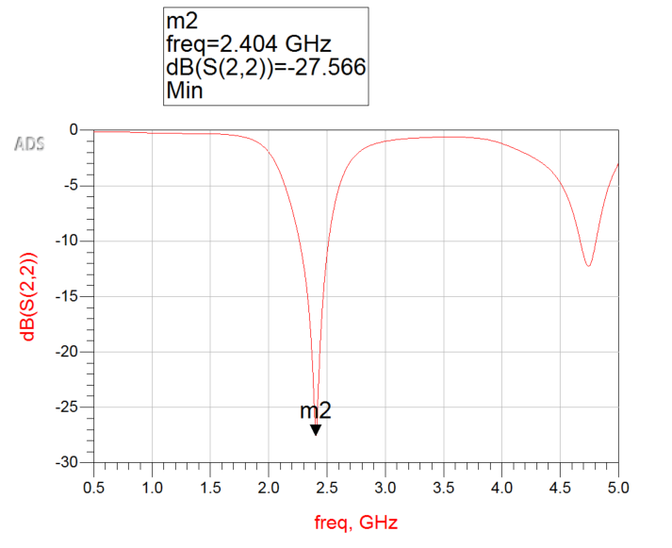
RF Testing and Tuning
p. 56
Notes:
Matt

Slide 27
RF Testing and Tuning
p. 55
Notes:
Matt

Slide 28
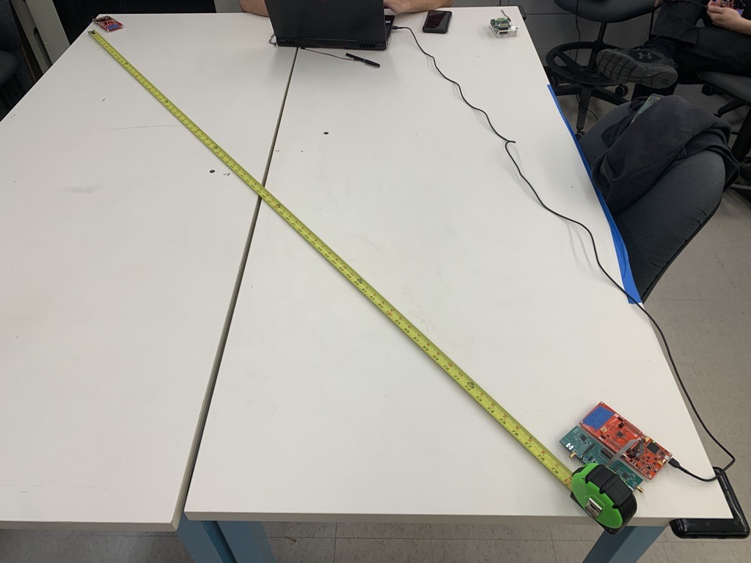
Radio Testing with TI SmartRF Studio
2.4GHz Wireless Testing
Test Configuration | RSSI (dBm)
REF1 → REF2 | -52.7
REF1 ← REF2 | -53.7
Sniffer (1) → REF2 | -53.1
Sniffer (1) ← REF2 | -53.1
p. 46, 56
Notes:
Matt

Slide 29
Radio Testing with TI SmartRF Studio
Sub-1GHz Wireless Testing
Test Configuration | RSSI (dBm)
REF1 → REF2 | -31.9
REF1 ← REF2 | -39.8
Sniffer (1) → REF2 | -80.2
Sniffer (1) ← REF2 | -80.8
Sniffer (2) → REF2 | -39.2
Sniffer (2) ← REF2 | -33.4
p. 46, 56
Notes:
Matt

Slide 30
Demo
p. 57
Notes:
Spencer

Slide 31
Challenges & Lessons Learned
Hardware
RF design
Multiple PCBs
Software
Real Time Operating System
Multiple Code bases
Multi-threading
Interrupt based programming
Integration Challenges
CC1352 Revision with Errata
CC1352 breaking due to clock issues
Notes:
Thomas

Slide 32
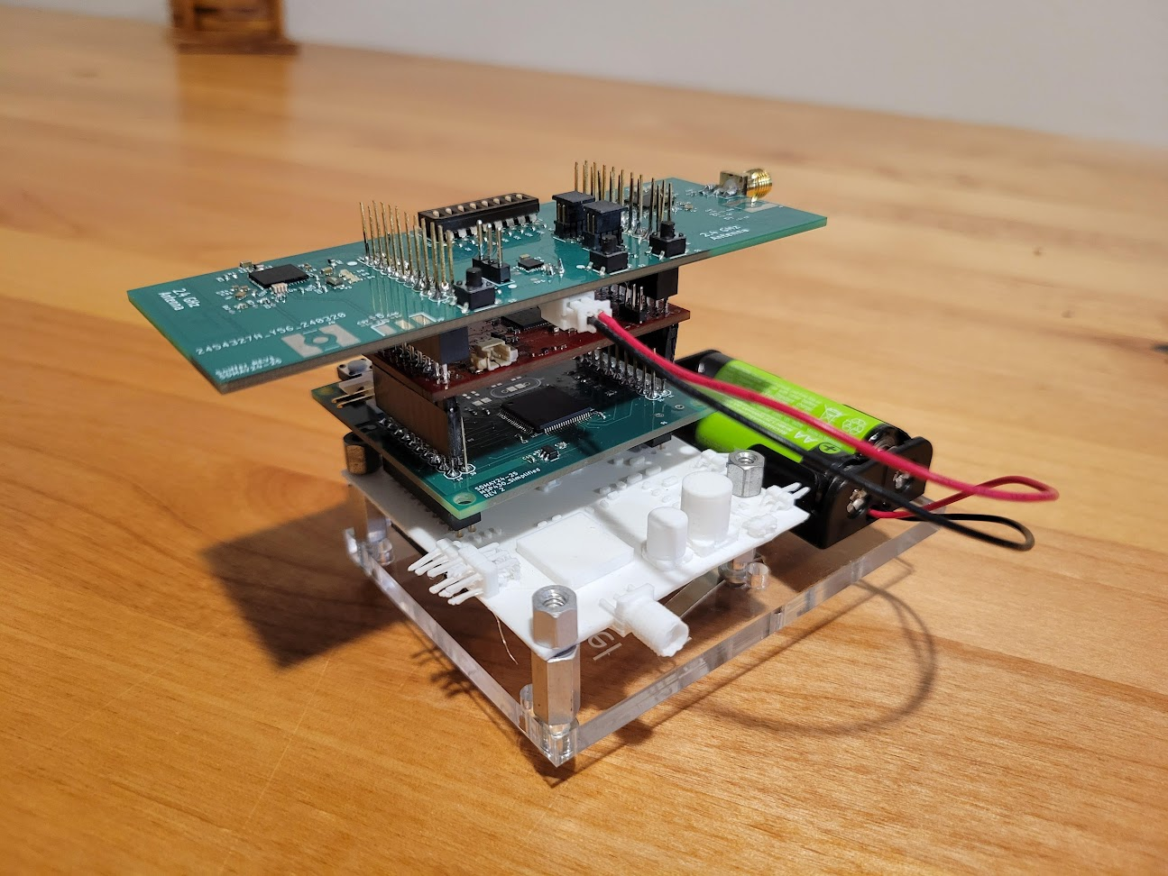
Future Work
Integrating more nodes into the communication network.
More rigorous load testing to ensure no packet loss
Integrate project with researcher's testbed
p. 81

Slide 33
Back-up Slides
Notes:
33

Slide 34
Literature Study
"Experimental Study of Lifecycle Management Protocols for Batteryless Intermittent Communication"[2]
"Toward a Shared Sense of Time for a Network of Batteryless, Intermittently-powered Nodes"[3]
"Reliable Timekeeping for Intermittent Computing"[4]
Notes:
Tori
Simplify down first sentecne
Implement slide for the msp after this
Note for slide deck: get rid of hiden slides. Bring physical PCB to presentation.
What is an MSP and why are we simplifying it?

Slide 35
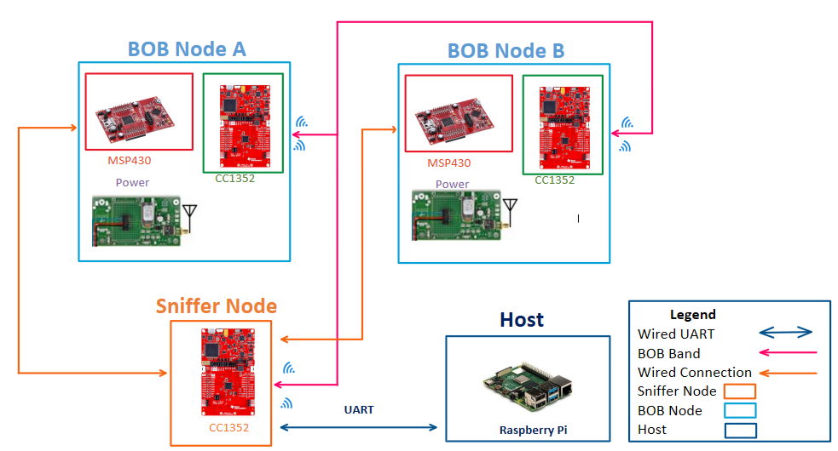
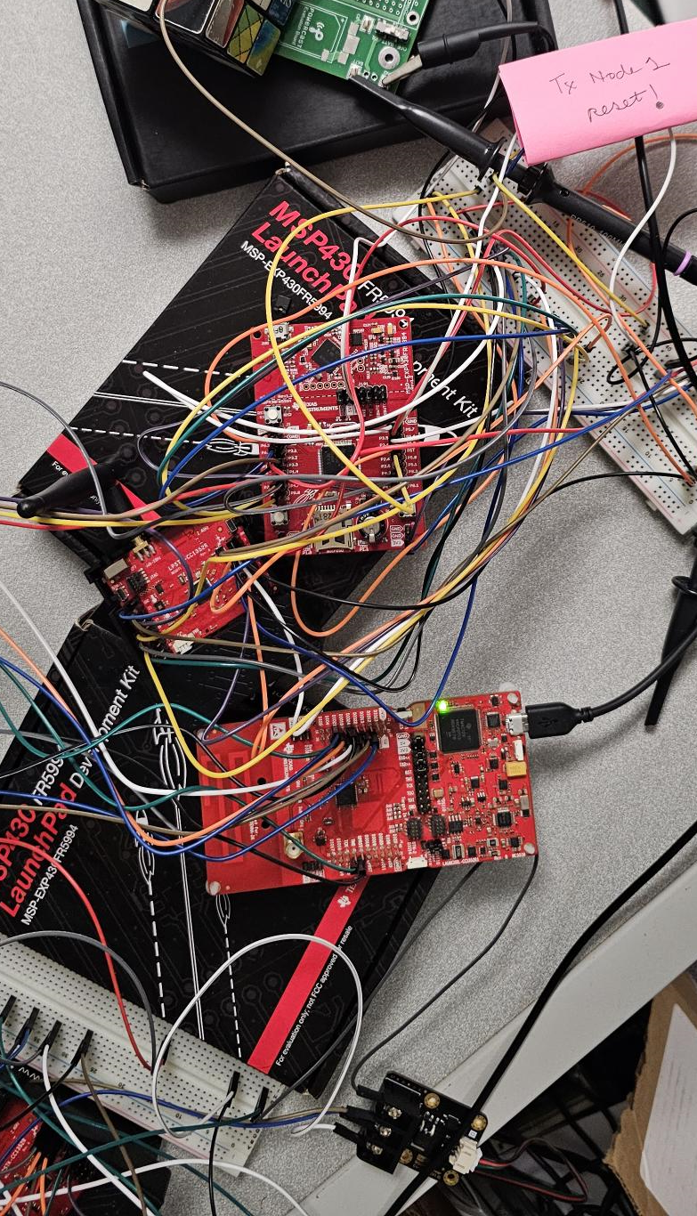
Current Design
p. 17
Notes:
Update power board

Slide 36
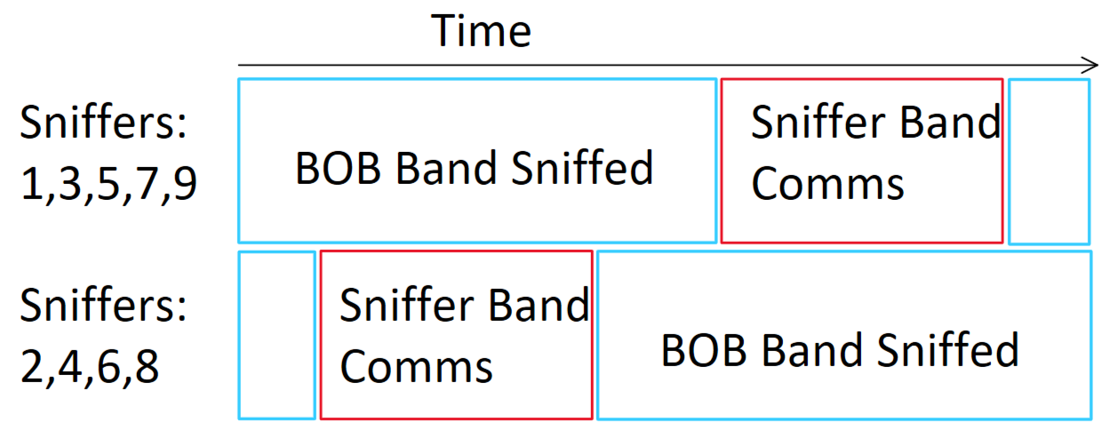
System Design
Wired Connection
Sink Band Comm. (2.4GHz)
BOB Communication (Sub 1GHz)
Listening to BOB Band
Communicating on Sink Band
Sniffer 1
BOB 1
Sniffer 4
BOB 4
Sniffer 7
BOB 7
Host
Sink
Sniffer 2
BOB 2
Sniffer 5
BOB 5
Sniffer 8
BOB 8
Sniffer 3
BOB 3
Sniffer 6
BOB 6
Sniffer 9
BOB 9
p. 91
Notes:
Fix animation, increase bottom figure text size, BOB band listening/ sniffing, receive/retransmit
Very cluttered, I love it

Slide 37
System Design
Wired Connection
Sink Band Comm. (2.4GHz)
BOB Communication (Sub 1GHz)
Listening to BOB Band
Communicating on Sink Band
Sniffer 1
BOB 1
Sniffer 4
BOB 4
Sniffer 7
BOB 7
Host
Sink
Sniffer 2
BOB 2
Sniffer 5
BOB 5
Sniffer 8
BOB 8
Sniffer 3
BOB 3
Sniffer 6
BOB 6
Sniffer 9
BOB 9
p. 91
Notes:
Fix animation, increase bottom figure text size, BOB band listening/ sniffing, receive/retransmit
Very cluttered, I love it

Slide 38
System Design
Wired Connection
Sink Band Comm. (2.4GHz)
BOB Communication (Sub 1GHz)
Listening to BOB Band
Communicating on Sink Band
Sniffer 1
BOB 1
Sniffer 4
BOB 4
Sniffer 7
BOB 7
Host
Sink
Sniffer 2
BOB 2
Sniffer 5
BOB 5
Sniffer 8
BOB 8
Sniffer 3
BOB 3
Sniffer 6
BOB 6
Sniffer 9
BOB 9
p. 91
Notes:
Fix animation, increase bottom figure text size, BOB band listening/ sniffing, receive/retransmit
Very cluttered, I love it

Slide 39
Hardware Cost Estimates
Breakout Board PCB Total Cost (5 boards): $20
Cost Per Breakout Board ​
MSP Simplified PCB Total Cost (10 boards): $31
Approximate Cost Per Board
Breakout Board | ~$17
MSP Simplified | ~$31
Cost Per MSP Simplified Single Board Cost
Notes:
Tori
Simplify down first sentecne
Implement slide for the msp after this
Note for slide deck: get rid of hiden slides. Bring physical PCB to presentation.
What is an MSP and why are we simplifying it?

Slide 40
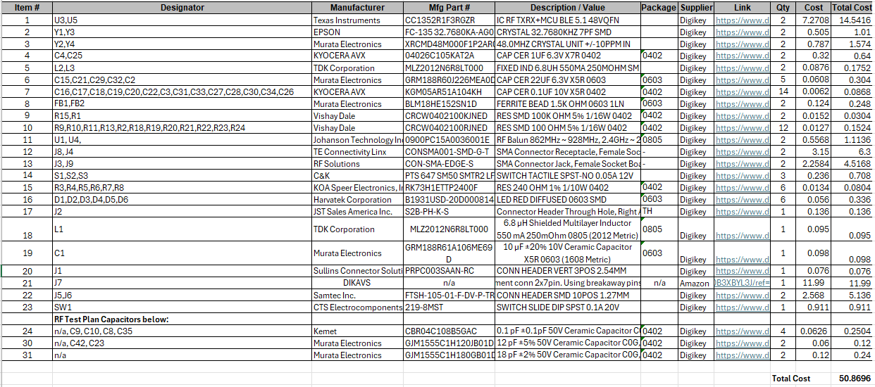
Hardware Cost Estimates
Sniffer PCB and Stencil Total Cost (15 boards): $81
Approximate Cost Per Board
Sniffer Board | ~$56
Note for Self: add battery cost into this
Cost Per Sniffer Single Board Cost
Notes:
Tori
Simplify down first sentecne
Implement slide for the msp after this
Note for slide deck: get rid of hiden slides. Bring physical PCB to presentation.
What is an MSP and why are we simplifying it?

Slide 41
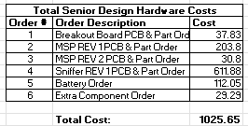
Hardware Cost Estimates

Slide 42
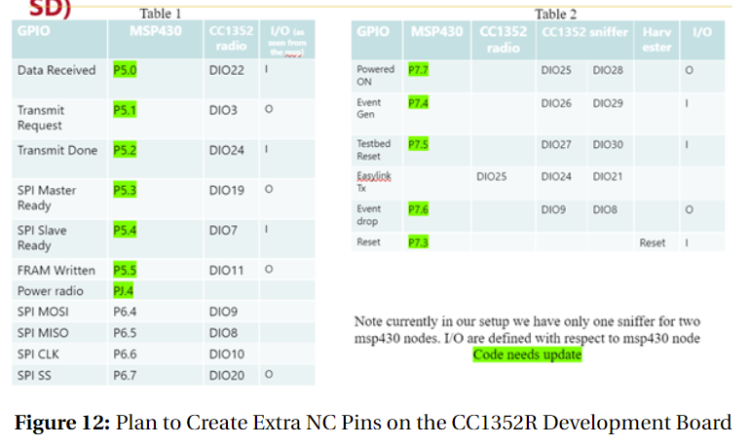
Stack Pinouts
Notes:
Tori
Simplify down first sentecne
Implement slide for the msp after this
Note for slide deck: get rid of hiden slides. Bring physical PCB to presentation.
What is an MSP and why are we simplifying it?

Slide 43
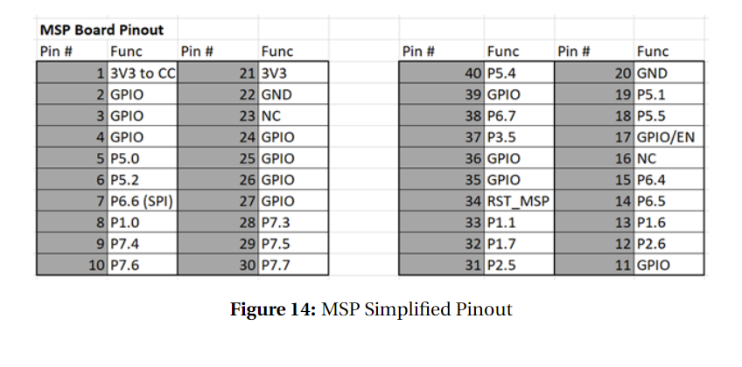
Stack Pinouts
Notes:
Tori
Simplify down first sentecne
Implement slide for the msp after this
Note for slide deck: get rid of hiden slides. Bring physical PCB to presentation.
What is an MSP and why are we simplifying it?

Slide 44
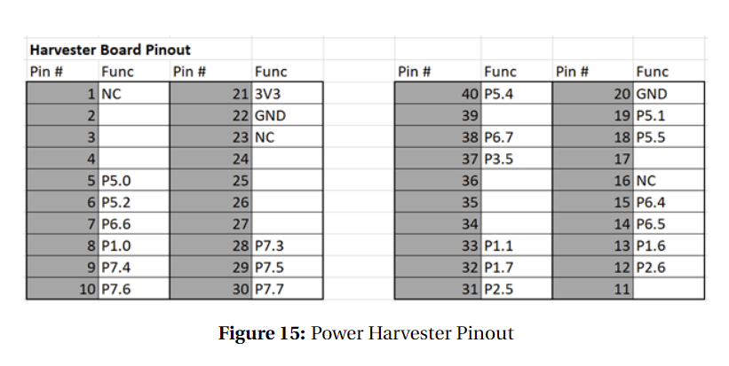
Stack Pinouts
Notes:
Tori
Simplify down first sentecne
Implement slide for the msp after this
Note for slide deck: get rid of hiden slides. Bring physical PCB to presentation.
What is an MSP and why are we simplifying it?

Slide 45
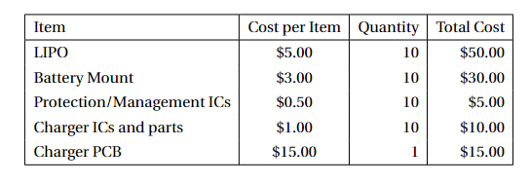
LIPO Cost Estimate (Slightly Outdated)
Cost per board: $11.00
Updated cost per board (no charging board): $9.5

Slide 46
Time Skew Analysis
CC1352 clock was ran with constant time reporting, compared to real-time clock
Skew ended up > .005%, .01% between any given 2 nodes
Two nodes skewing in opposite directions: take 50 seconds to skew by 5 ms

Slide 47
Prototype Implementations - ????
No Transmit | Min | Max | Mean
Power (mW) | 4.6707 | 7.5945 | 5.9900
Current (mA) | 1.4154 | 2.3014 | 1.8152
Transmit every 5ms | Min | Max | Mean
Power (mW) | 4.6707 | 7.5945 | 5.9900
Current (mA) | 1.4154 | 2.3014 | 1.8152
p. 37-38

Slide 48
Prototype Implementations - ????
No Transmit | Min | Max | Mean
Power (mW) | 4.6707 | 7.5945 | 5.9900
Current (mA) | 1.4154 | 2.3014 | 1.8152
Transmit every 5ms | Min | Max | Mean
Power (mW) | 4.6707 | 7.5945 | 5.9900
Current (mA) | 1.4154 | 2.3014 | 1.8152
+10% buffer
p. 37-38

Slide 49
References
[1] “CC13xx/CC26xx Hardware Configuration and PCB Design Considerations.” Accessed: Dec. 04, 2023. [Online]. Available: https://www.ti.com/lit/an/swra640g/swra640g.pdf?ts=1701669788758&ref_url=https%253A%252F%252Fwww.google.com%252F
[2] V. Deep et al., "Experimental Study of Lifecycle Management Protocols for Batteryless Intermittent Communication," 2021 IEEE 18th International Conference on Mobile Ad Hoc and Smart Systems (MASS), Denver, CO, USA, 2021, pp. 355-363, doi: 10.1109/MASS52906.2021.00052.
[3] V. Deep, M. L. Wymore, D. Qiao and H. Duwe, "Toward a Shared Sense of Time for a Network of Batteryless, Intermittently-powered Nodes," 2022 IEEE International Performance, Computing, and Communications Conference (IPCCC), Austin, TX, USA, 2022, pp. 138-146, doi: 10.1109/IPCCC55026.2022.9894317.
[4] Jasper de Winkel, Carlo Delle Donne, Kasim Sinan Yildirim, Przemysław Pawełczak, and Josiah Hester. 2020. Reliable Timekeeping for Intermittent Computing. In Proceedings of the Twenty-Fifth International Conference on Architectural Support for Programming Languages and Operating Systems (ASPLOS '20). Association for Computing Machinery, New York, NY, USA, 53–67. https://doi.org/10.1145/3373376.3378464
Notes:
Tori
Simplify down first sentecne
Implement slide for the msp after this
Note for slide deck: get rid of hiden slides. Bring physical PCB to presentation.
What is an MSP and why are we simplifying it?

Slide 50
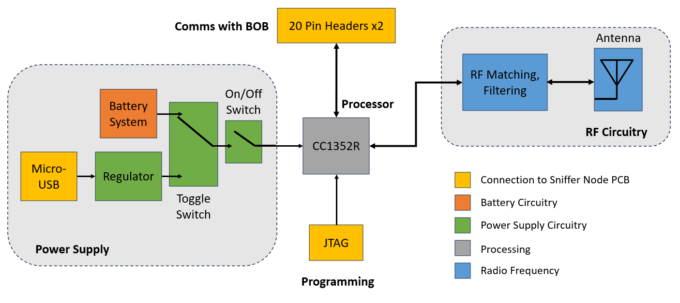
Conceptual Design Diagram - Hardware
Notes:
Matt Do not talk about 2 cc1352s
Design of single Sniffer Node
All implemented on a single PCB
RF portion will be based on TI reference designs
JTAG – standard interface
Header based on TI "BoosterPack" with custom pin locations
Custom Power Supply Design
Good design. Yellow harder to read. 'Radio Analog circuitry' in the key. 'rena

Slide 51
System Design
UART Connection
Sniffer Band Comm. (2.4GHz)
Sniffer 0x00
Sniffer 0x08
Sniffer 0x10
Host
Sink
Sniffer 0x01
Sniffer 0x09
Sniffer 0x11
Sniffer 0x02
Sniffer 0x0A
Sniffer 0x12
Notes:
Fix animation, increase bottom figure text size, BOB band listening/ sniffing, receive/retransmit
Very cluttered, I love it

Slide 52
System Design
Sniffer:
Wired Event Generation
Sniffer Network
CC1352
Primary
BOB
Power Monitor
SPI
BOB Comm.
(Sub 1GHz)
Sniffer Band Comm. (2.4GHz)
"Sniffed"
Comm.
CC1352
Relay
BOB
Notes:
Fix animation, increase bottom figure text size, BOB band listening/ sniffing, receive/retransmit
Very cluttered, I love it

Slide 53
System Design
Sniffer Band Comm. (2.4GHz)
UART Connection
Sniffer 0x00
Sniffer 0x08
Sniffer 0x10
Host
Sink
Sniffer 0x01
Sniffer 0x09
Sniffer 0x11
Sniffer 0x02
Sniffer 0x0A
Sniffer 0x12
Notes:
Fix animation, increase bottom figure text size, BOB band listening/ sniffing, receive/retransmit
Very cluttered, I love it

Slide 54
Sniffer PCB Design – KiCad Schematics
p. ADD ME

Slide 55
Sniffer PCB Design – KiCad Schematics
p. ADD ME

Slide 56
Thank you! :)

Slide 57
Sniffer PCB Design – KiCad Schematics
p. ADD ME

