Slide 1
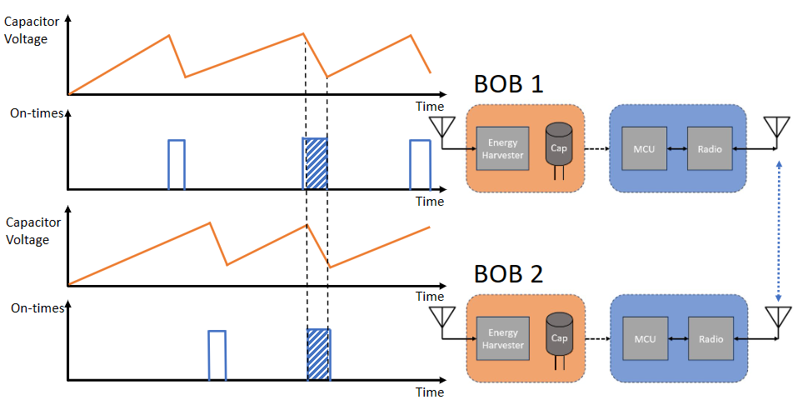
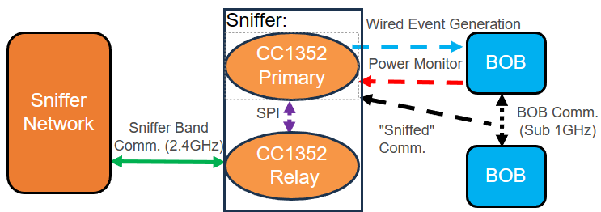
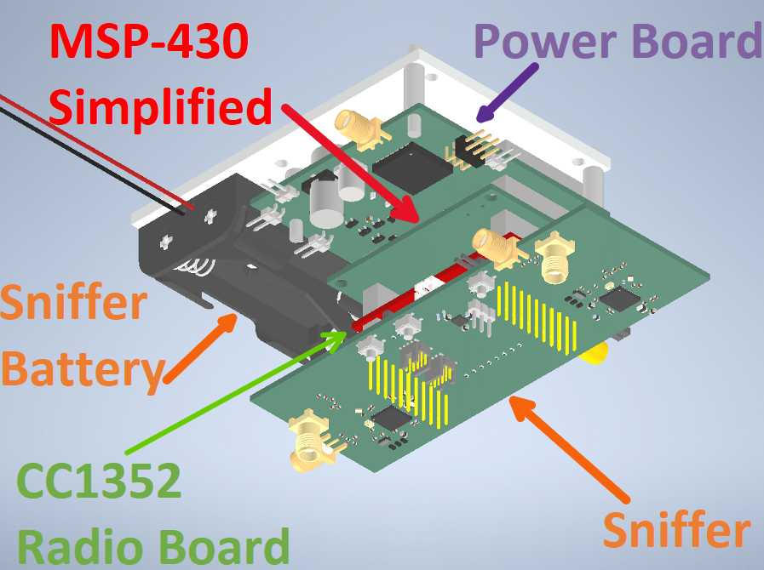
Distributed Sniffer Nodes for Batteryless Sensor Nodes
Ian Hollingworth | Mathew Crabb | Spencer Sutton | Tori Kittleson | Thomas Gaul
Group #: sdmay24-25
Advisor/Client: Dr. Henry Duwe
Introduction
Dr. Duwe’s research team conduct research on a network of batteryless sensor nodes or a BOB nodes
BOB nodes have complicated communication cycles
Our group created a testbed to configure and monitor multi-BOB note network
Users and Purposes
Users
Dr. Duwe and research team
Other universities and researchers
Open-Source community
Purpose
Evaluate and debug protocols & system designs of sensor node networks through physical and wireless data
Design Approach
Design Requirements
Two CC1352s in a Sniffer Node one to record data one to transmit it
Connected via SPI
Monitoring of BOB on times, transmission times, and transmissions
Network system that sends the data back to the Host
2.4-GHz communication for Sniffer communication
Sub-1-GHZ communication for BOB monitoring
Battery pack to power the Sniffer Node and isolate it from other nodes
Sniffer node powered continuously for one week
Sniffer nodes have a negligible effect on BOB’s lifetime
Modular Stack of BOB and Sniffers
Scalable for larger (100+) node setup
Sniffer Node Software
9 Sniffer, BOB node pairs
Mechanically sound system for lab
Components
Sniffer: monitor BOB node’s activities
Primary CC1352: monitor wireless activity and power cycles
Relay CC1352: pass data through the Sniffer network for record
CC1352 Radio: BOB’s communication radio
Simplified MSP-430: part of BOB with paired-down hardware from the MSP-430 development board
Power Board: radio frequency energy harvester powering the BOB designed by the research team
Mounting plate: Mounts BOB, Sniffer stack to the ceiling of the lab
Senior Design Cost Breakdown ($)
Break Board | $37.83
Simplified MSP-430 | $234.60
Sniffer Board | $611.88
Batteries | $112.05
Extra parts | $29.29
Mechanical Design | $34.60
Total | $1060.25
Tools and Standards
Python
SPI
UART
CST Studio Suite
Keysight ADS
C
KiCAD
TI Code Composer Studios
Autodesk Inventor
EasyLink
Testing
Hardware Testing
PCB testing post-fabrication
CST Studio Suite RF simulation software
Radio testing
System tests used a "Faux BOB" we designed to emulate a BOB with a single cc1352
Transmit radio packets on the Sub-1-GHz Band
Emulate BOB power and transmit cycle with GPIO

Slide 2
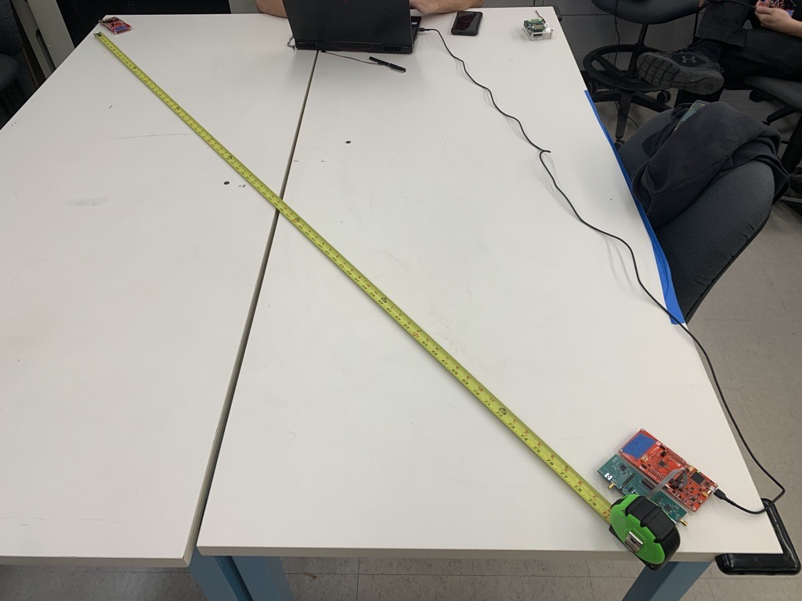
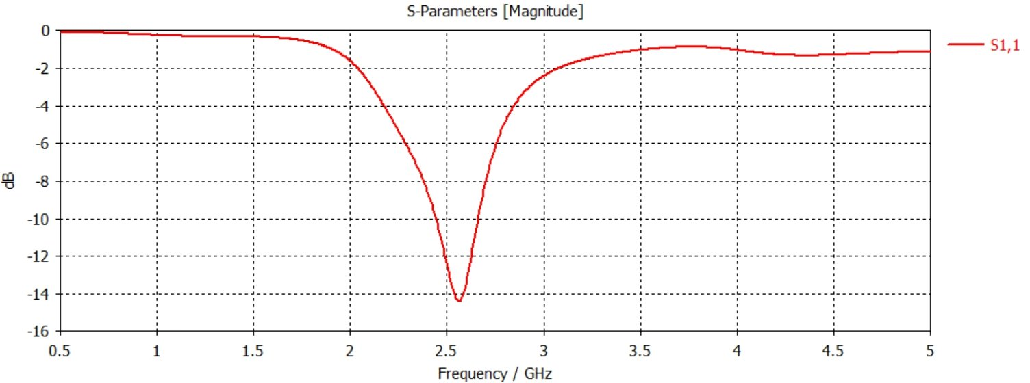
Distributed Sniffer Nodes for Batteryless Sensor Nodes
Ian Hollingworth | Matthew Crabb | Spencer Sutton | Tori Kittleson | Thomas Gaul
Group #: sdmay24-25
Advisor/Client: Dr. Henry Duwe
Introduction
Dr. Duwe’s research team conducts research on a network of batteryless sensor nodes called BOB nodes
BOB nodes have complicated communication cycles
Our group created a testbed to configure and monitor a multi-BOB node network
Users and Purposes
Users
Dr. Duwe and research team
Other universities and researchers
Open-Source community
Purpose
Evaluate and debug protocols and system designs of sensor node networks through physical and wireless data
Design Approach
Design Requirements
Two CC1352s in a Sniffer Node one to record data one to transmit it
Connected via SPI
Monitoring of BOB on times, transmission times, and transmissions
Network system that sends the data back to the Host
2.4-GHz band used for Sniffer communication
Sub-1-GHZ band used for BOB monitoring
Battery pack to power the Sniffer Node and isolate it from other nodes
Sniffer node powered continuously for one week
Sniffer node have a negligible effect on BOB’s lifetime
Modular Stack of BOB and Sniffers
Scalable for larger (100+) node setup
Sniffer Node Software
9 Sniffer, BOB node pairs
Mechanically sound system for lab
Components
Sniffer: Monitor BOB node’s activities
Primary CC1352: Collect data
Relay CC1352: Pass data down Sniffer network to the Host
CC1352 Radio: BOB communication
Simplified MSP-430: BOB computation – simplified by our team to total costs of node production
Power Board: Harvests RF energy
Mounting plate: Mounts BOB, Sniffer stack to the ceiling of the lab
Testing
Sub-1GHz Wireless Testing
DUT | RSSI (dBm)
REF1 → REF2 | -31.9
REF1 ← REF2 | -39.8
Sniffer (1) → REF2 | -80.2
Sniffer (1) ← REF2 | -80.8
Sniffer (2) → REF2 | -39.2
Sniffer (2) ← REF2 | -33.4
Hardware Testing
PCB testing post-fabrication
CST Studio Suite antenna modeling
System tests used a "Faux BOB" we designed to emulate a BOB with a single CC1352 – Emulates actual BOB operation
Wireless testing – Using TI SmartRF Studio
Compared performance to TI development boards (REF1, REF2)
Measured RSSI (Received Signal Strength Indicator)
2.4GHz Wireless Testing
DUT | RSSI (dBm)
REF1 → REF2 | -52.7
REF1 ← REF2 | -53.7
Sniffer (1) → REF2 | -53.1
Sniffer (1) ← REF2 | -53.1
Tools and Standards
Python
SPI
UART
CST Studio Suite
Keysight ADS
C
TI Code Composer Studio
Autodesk Inventor
EasyLink
KiCAD
Senior Design Cost Breakdown ($)
Break Board | $37.83
Simplified MSP-430 | $234.60
Sniffer Board | $611.88
Batteries | $112.05
Extra parts | $29.29
Mechanical Design | $34.60
Total | $1060.25

Slide 3
Distributed Sniffer Nodes for Batteryless Sensor Nodes
Ian Hollingworth | Matthew Crabb | Spencer Sutton | Tori Kittleson | Thomas Gaul
Group #: sdmay24-25
Advisor/Client: Dr. Henry Duwe
Introduction
Dr. Duwe’s research team conducts research on a network of batteryless sensor nodes or a BOB nodes
BOB nodes have complicated communication cycles
Our group created a testbed to configure and monitor multi-BOB note network
Users and Purposes
Users
Dr. Duwe and research team
Other universities and researchers
Open-Source community
Purpose
Evaluate and debug protocols and system designs of sensor node networks through physical and wireless data
Design Approach
Design Requirements
Two CC1352s in a Sniffer Node one to record data one to transmit it
Connected via SPI
Monitoring of BOB on times, transmission times, and transmissions
Network system that sends the data back to the Host
2.4-GHz communication for Sniffer communication
Sub-1-GHZ communication for BOB monitoring
Battery pack to power the Sniffer Node and isolate it from other nodes
Sniffer node powered continuously for one week
Sniffer nodes have a negligible effect on BOB’s lifetime
Modular Stack of BOB and Sniffers
Scalable for larger (100+) node setup
Sniffer Node Software
9 Sniffer, BOB node pairs
Mechanically sound system for lab
Components
Sniffer: Monitor BOB node’s activities
Primary CC1352: Collect data
Relay CC1352: Pass data down Sniffer network to the Host
CC1352 Radio: BOB communication
Simplified MSP-430: BOB computation – simplified by our team to total costs of node production
Power Board: Harvests RF energy
Mounting plate: Mounts BOB, Sniffer stack to the ceiling of the lab
Testing
Hardware Testing
PCB testing post-fabrication
CST Studio Suite antenna modeling
System tests used a "Faux BOB" we designed to emulate a BOB with a single CC1352 – Emulates actual BOB operation
Wireless testing – Using TI SmartRF Studio
Compared performance to TI development boards (REF1, REF2)
Measured RSSI (Received Signal Strength Indicator) results below
Sub-1GHz Wireless Testing
DUT | RSSI (dBm)
REF1 → REF2 | -31.9
REF1 ← REF2 | -39.8
Sniffer (1) → REF2 | -80.2
Sniffer (1) ← REF2 | -80.8
Sniffer (2) → REF2 | -39.2
Sniffer (2) ← REF2 | -33.4
Tools and Standards
Python
SPI
UART
CST Studio Suite
Keysight ADS
C
TI Code Composer Studio
Autodesk Inventor
EasyLink
KiCAD
Senior Design Cost Breakdown ($)
Break Board | $37.83
Simplified MSP-430 | $234.60
Sniffer Board | $611.88
Batteries | $112.05
Extra parts | $29.29
Mechanical Design | $34.60
Total | $1060.25
2.4GHz Wireless Testing
DUT | RSSI (dBm)
REF1 → REF2 | -52.7
REF1 ← REF2 | -53.7
Sniffer (1) → REF2 | -53.1
Sniffer (1) ← REF2 | -53.1

Slide 4
Distributed Sniffer Nodes for Batteryless Sensor Nodes
Ian Hollingworth | Matthew Crabb | Spencer Sutton | Tori Kittleson | Thomas Gaul
Group #: sdmay24-25
Advisor/Client: Dr. Henry Duwe
Introduction
Dr. Duwe’s research team conducts research on a network of batteryless sensor nodes called a BOB nodes
BOB nodes have complicated communication cycles
Our group created a testbed to configure and monitor multi-BOB note network
Users and Purposes
Users
Dr. Duwe and research team
Other universities and researchers
Open-Source community
Purpose
Evaluate and debug protocols and system designs of sensor node networks through physical and wireless data
Design Approach
Design Requirements
Two CC1352s in a Sniffer Node one to record data one to transmit it
Connected via SPI
Monitoring of BOB on times, transmission times, and transmissions
Network system that sends the data back to the Host
2.4-GHz band used for Sniffer communication
Sub-1-GHZ band used for BOB monitoring
Battery pack to power the Sniffer Node and isolate it from other nodes
Sniffer node powered continuously for one week
Sniffer node has a negligible effect on BOB’s lifetime
Modular Stack of BOB and Sniffers
Scalable for larger (100+) node setup
Sniffer Node Software
9 Sniffer, BOB node pairs
Mechanically sound system for lab
Components
Sniffer: Monitor BOB node’s activities
Primary CC1352: Collect data
Relay CC1352: Pass data down Sniffer network to the Host
CC1352 Radio: BOB communication
Simplified MSP-430: BOB computation – simplified by our team to total costs of node production
Power Board: Harvest RF energy
Mounting Plate: Mount BOB, Sniffer stack to the ceiling of the lab
Testing
Hardware Testing
PCB testing post-fabrication
CST Studio Suite antenna modeling
System Tests used a "Faux BOB" we designed to emulate a BOB with a single CC1352 – Emulates actual BOB operation
Wireless Testing – Using TI SmartRF Studio
Compared performance to TI development boards (REF1, REF2)
Measured RSSI (Received Signal Strength Indicator) results below
Sub-1GHz Wireless Testing
DUT | RSSI (dBm)
REF1 → REF2 | -31.9
REF1 ← REF2 | -39.8
Sniffer (1) → REF2 | -80.2
Sniffer (1) ← REF2 | -80.8
Sniffer (2) → REF2 | -39.2
Sniffer (2) ← REF2 | -33.4
Tools and Standards
Python
SPI
UART
CST Studio Suite
Keysight ADS
C
TI Code Composer Studio
Autodesk Inventor
EasyLink
KiCAD
CST Studio Suite Model of 2.4GHz PCB Antenna
Senior Design Cost Breakdown ($)
Breakout Board | $37.83
Simplified MSP-430 | $234.60
Sniffer Board | $611.88
Batteries | $112.05
Extra Parts | $29.29
Mechanical Design | $34.60
Total | $1060.25
2.4GHz Wireless Testing
DUT | RSSI (dBm)
REF1 → REF2 | -52.7
REF1 ← REF2 | -53.7
Sniffer (1) → REF2 | -53.1
Sniffer (1) ← REF2 | -53.1
2.4GHz PCB Antenna S-Parameters from Simulation

